Slide 1

IoT Based Automated Weather Report Generation and Prediction Using Machine Learning
Apoorva Parashar Anubha Parashar Computer Science and Engineering Computer Science and Engineering Maharshi Dayanand University Rohtak, India Manipal University Jaipur

Slide 2
Contents
Introduction
About the project
Literature review
Problem statement
Solution
Methodology and Related Diagrams
Planning
Work done
Dataset and Feature selection
Result Analysis
Conclusion

Slide 3

Introduction
Weather forecasting is the application of science and technology to predict the state of the atmosphere for a given location.
Weather is driven by air pressure (temperature and moisture) differences between one place and another. This pressure and temperature differences can occur due to the sun angle at any particular spot, which varies by latitude from the tropics.
The atmosphere is a chaotic system, so small changes to one part of the system can grow to have large effects on the system as a whole. This makes it difficult to accurately predict weather few days in advance.

Slide 4
About the Project
We aim to create a Weather Monitoring Device which would measure various parameters such as : Temperature , Humidity , Pressure , Rain Fall , PM concentration , CO concentration etc.
These data would then be sent to cloud using wifi module where analysis will be conducted using Matlab.
Our web portal will be showing a graphical presentation of our collected data.
With the help of Machine Learning we aim to forecast the weather of coming days. Air quality for an area will also be displayed.

Slide 5
Literature Survey
1. Forecasting power output of photovoltaic systems based on weather classification and support vector machines, J Shi, WJ Lee, Y Liu, Y Yang IEEE Transactions on 2012
1
2 . Predicting weather events using fuzzy rule based system, MSK Awan, MM Awais - Applied Soft Computing, 2015 - Elsevier
2
3. Diagnosis of “forecast analysis” differences of a weather prediction system S Dirren, M Didone, HC Davies - Geophysical research letters, 2016 - Wiley Online Library
3
4. The Advanced Regional Prediction System (ARPS), storm-scale numerical weather prediction and data assimilation
M Xue, D Wang, J Gao, K Brewster 2016 - Springer
4

Slide 6
After reviewing many articles, there are presently no papers that mention monitoring the combination of more features like temperature, lighting and humidity in one integrated system .
In addition to this, there is one research paper that has discussed monitoring these three environmental conditions; however, there has been no mention about forecasting Temperature using it .
So our main idea was to coin a system that can sense the main components that formulates the weather and can be able to forecast the weather without human error.

Slide 7
Problem Statement
Though there are few weather reporting models which already exist but in today’s world except for weather, concentration of various components of air and its quality are also gaining importance.
(An operational system for generating impact of air quality in the Australian region and their impact on numerical weather prediction JL Marshall, N Pescod, B Seaman - Nature 2009)
There is no such model which can forecast weather, determine various components in air and can check or predict air quality.
Previous weather forecasting models used the complicated blend of mathematical instruments which was insufficient in order to get higher classification rate.
Using different components to collect and assess data will be expensive.

Slide 8

Solution
We in our project aim to integrate various sensors to collect data using which we can forecast weather and calculate air quality as well.
In our model, we are using more sensors and hence are generating and assessing more parameters.
Machine learning algorithms will be used which will help us to predict the weather of the coming days based on the historical data of that location hence aiming at higher accuracy at lower cost.
Also it will be the first setup which will monitor air quality along with forecasting weather and present it in real time.

Slide 9

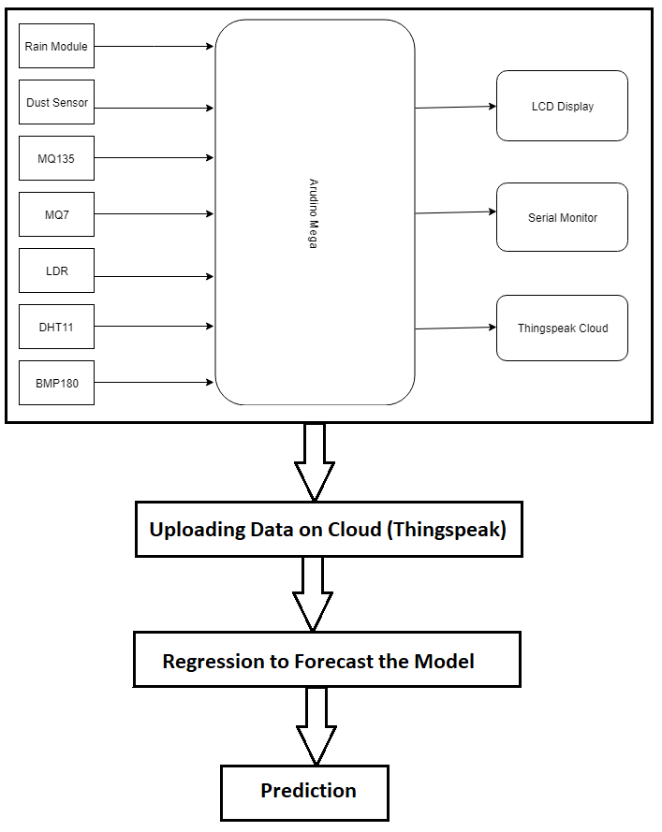



Methodology

Slide 10
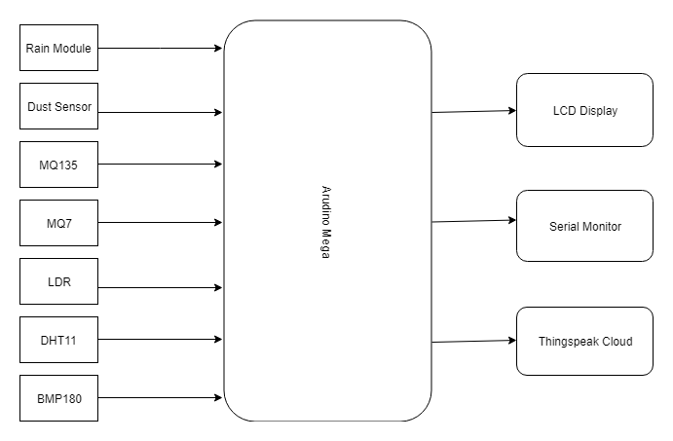
Architecture Design

Slide 11
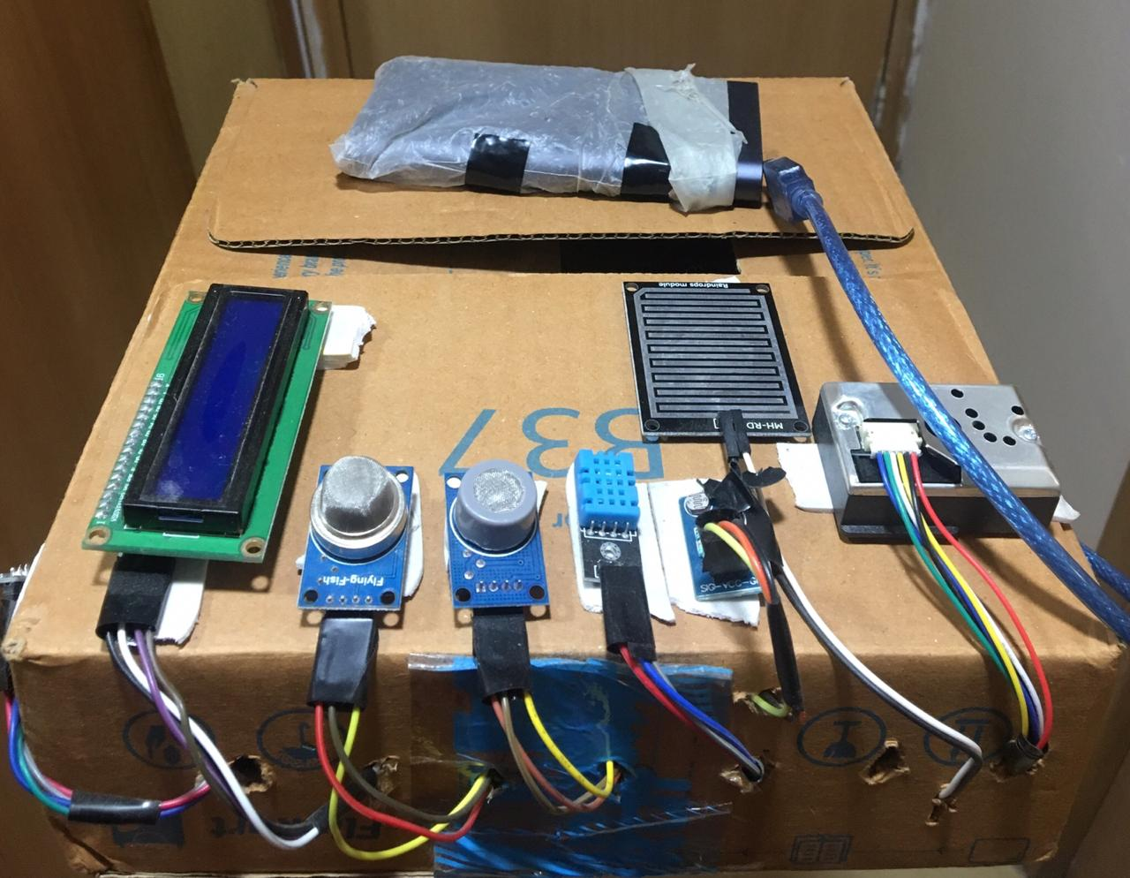


Slide 12
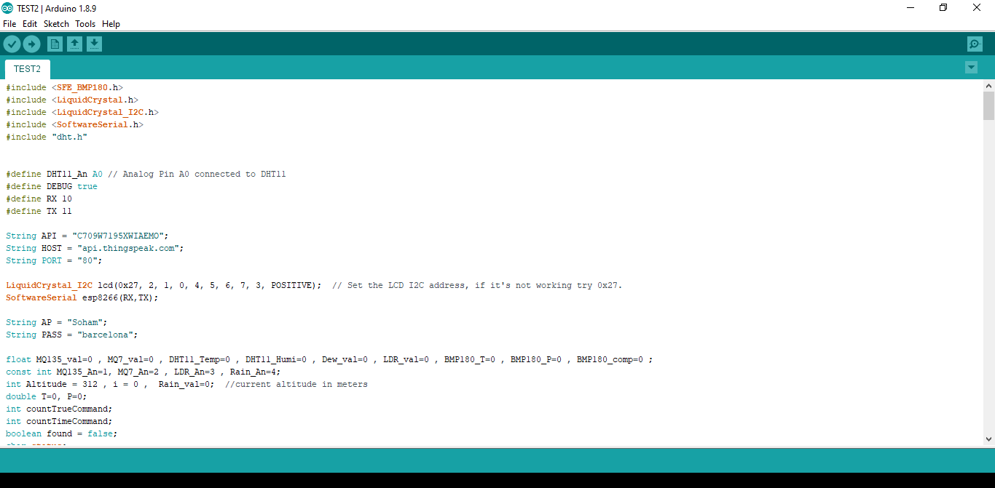

Slide 13
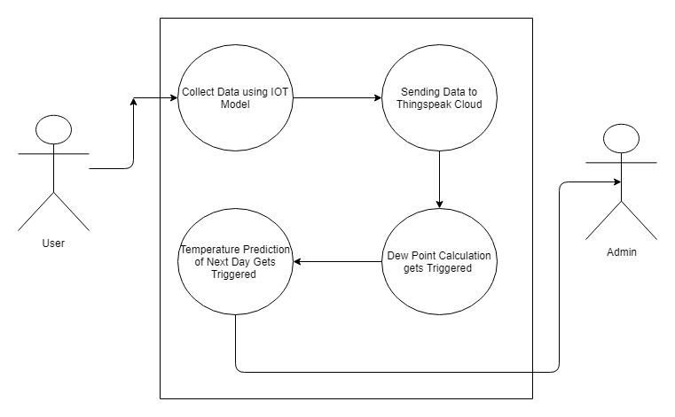
Use Case Diagram

Slide 14
Work done
Integration of Sensors
Web portal design
Connection of IoT device to cloud
Generation and Collection of data
Integration of IoT device to Web portal
Forecasting of Temperature

Slide 15
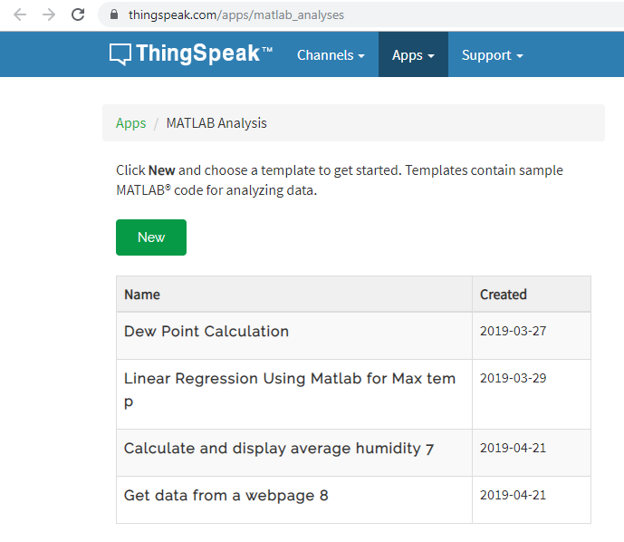
Work done

Slide 16
Dataset Collection
Dataset was collected from weather underground which is currently not providing free service. The dataset provides the data from 1st May 2016 to 11th March 2018. It gives a list of parameters:
Meantemp
Meandewpoint
Meanpressure
Maxhumidity
Minhumidity
Maxtemp
Mintemp
Maxdewpoint
Mindewpoint
Maxpressure
Minpressure

Slide 17
Dataset

Slide 18
Dataset
date meantempm maxtempm mintempm meantempm_1 meantempm_2 meantempm_3 meandewptm_1 meandewptm_2 meandewptm_3 meanpressurem_1 meanpressurem_2 meanpressurem_3 maxhumidity_1 maxhumidity_2 maxhumidity_3 minhumidity_1 minhumidity_2 minhumidity_3 maxtempm_1 maxtempm_2 maxtempm_3 mintempm_1 mintempm_2 mintempm_3 maxdewptm_1 maxdewptm_2 maxdewptm_3 mindewptm_1 mindewptm_2 mindewptm_3 maxpressurem_1 maxpressurem_2 maxpressurem_3 minpressurem_1 minpressurem_2 minpressurem_3 precipm_1 precipm_2 precipm_3
5/4/2016 34 41 27 35 36 34 6 4 -1 1006 1005.46 1005.63 27 21 24 5 6 4 41 43 43 29 29 26 12 10 9 -2 -2 -10 1009 1008 1009 1000 1001 999 0 0 0
5/5/2016 31 38 24 34 35 36 7 6 4 1005.65 1006 1005.46 29 27 21 6 5 6 41 41 43 27 29 29 13 12 10 0 -2 -2 1008 1009 1008 1001 1000 1001 0 0 0

Slide 19
Feature Selection
For finding out the relevant parameters we conducted various test:
Correlation Check: Correlation is a statistical technique that can show whether and how strongly pairs of variables are related. For example, height and weight are related; taller people tend to be heavier than shorter people.
P Value Check: The p-value is the level of marginal significance within a statistical hypothesis test representing the probability of the occurrence of a given event. The p-value is used as an alternative to rejection points to provide the smallest level of significance at which null hypothesis would be rejected. A smaller p-value means that there is stronger evidence in favor of the alternative hypothesis.

Slide 20
Backward Stepwise Regression : It is a stepwise regression approach, that begins with a full (saturated) model and at each step gradually eliminates variables from the regression model to find a reduced model that best explains the data. Also known as Backward Elimination regression.
R-Squared and Adj R-Squared: R-squared measures the proportion of the variation in your dependent variable (Y) explained by your independent variables (X) for a linear regression model. Adjusted R-squared adjusts the statistic based on the number of independent variables in the model.

Slide 21
After conducting the following analysis the following parameters were identified:
1. For max temperature prediction:
Maxtempm_1 , Maxpressure_1 , Mintempm_3 , Maxpressure_3 , Meanpressurem_3
2. For min temperature prediction:
Mintempm_1 , Meantempm_3 , Maxtempm_1 ,Maxtempm_2 ,Maxdewptm_1 ,Maxdewptm_3 ,Meandewptm_1 ,Meandewptm_2 ,Meanpressure_1
3. For mean temperature prediction:
Meantemp_3 , Meanpressure_3 , Maxtemp_1 , Maxtemp_2 ,Mintemp_1

Slide 22
Results
Parameters | Current Temperature Accuracy is 99.05%
 | Next day Min Temperature Accuracy | Next day Max Temperature Accuracy | Next day Mean Temperature Accuracy
Explained variance | 0.94 | 0.93 | 0.95
Mean absolute error | 1.35 degree Celsius | 1.29 degree Celsius | 1.10 degree Celsius
Median absolute error | 1.09 degree Celsius | 0.97 degree Celsius | 0.90 degree Celsius

Slide 23
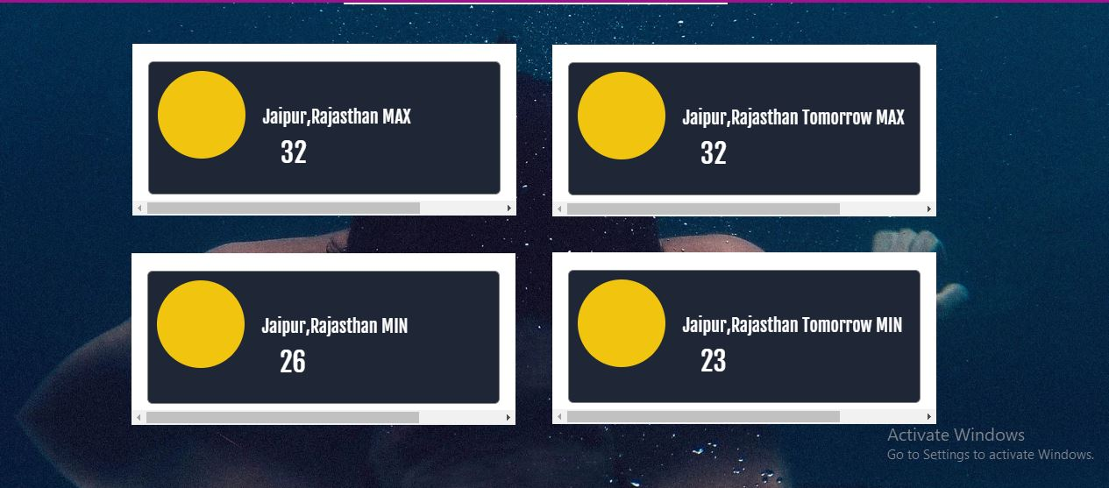
Results

Slide 24
Result Analysis
Current Temperature Accuracy: Temperature shown contains an error of 0.5 degree Celsius.
Next day Min Temperature Accuracy:
Explained variance= 0.94
Mean absolute error= 1.35 degree Celsius
Median absolute error= 1.09 degree Celsius

Slide 25
Next day Max Temperature Accuracy:
Explained variance= 0.93
Mean absolute error= 1.29 degree Celsius
Median absolute error= 0.97 degree Celsius
Next day Mean Temperature Accuracy:
Explained variance= 0.95
Mean absolute error= 1.10 degree Celsius
Median absolute error= 0.90 degree Celsius

Slide 26
Future Scope
The model is able to sense the values and display current day’s temperature on the web portal. As of now, the model is also able to predict next day’s min and max temperature.
For the future, the model is expected to forecast weather and predict temperature for next few days. The model is also expected to calculate and predict air quality.
This model can further be extended to be used to study about the working conditions in different work environments and how they were impacting the work efficiency of the employees.

Slide 27
Conclusion
The real-time data i.e. time-series data is gathered, cleansing and analysis is performed on this dataset using Data Analytics.
Here the values are predicted by implementing linear regression using MATLAB, the prediction can be done for next few days. The proposed system to train the model takes dataset of last two years.
Finally, after cleansing of data, training the model, it finally displays current and predicted values of the temperature on the web portal.

Slide 28
Thank you
Have a nice weather!!!

